Slide 1
Chapters 1 and 2
Ch 1: Databses and Database Users
Ch 2: Database System Concepts and Architecture

Slide 2
Data Models, Schemas, and Instances
What is data abstraction?
  Suppress the details of the data organization and storage
  Highlight the essential features for an improved understanding of data
Data model
  Collection of concepts that describe the structure of a database
  Provides means to achieve data abstraction
  The description of a database is called the database schema
Basic operations
    Specify retrievals and updates on the database
Dynamic aspect or behavior of a database application
    Allows the database designer to specify a set of valid operations allowed on database objects

Slide 3
Overview
Thinking about databases:
  Traditional database applications
    Store textual or numeric information
  Multimedia databases
    Store images, audio clips, and video streams digitally
  Geographic information systems (GIS)
    Store and analyze maps, weather data, and satellite images
  Data warehouses and online analytical processing (OLAP)
    Extract and analyze useful business information from very large databases to support decision making
  Real-time and active database technology
    Control industrial and manufacturing processe
  Big data storage systems, or NOSQL systems
    Manage data for social media applications
    Provide cloud storage (storage capabilities on the web for managing all types of data)

Slide 4
What is a database?
A database has the following implicit properties:
  Represents some aspect of our real world, called also miniworld or universe of discourse (UoD).
  Logically coherent collection of data with some inherent meaning.
  Designed, built, and populated with data for a specific purpose.

Slide 5
What is a DBMS?
A database management system (DBMS) is a system that allows users to create and maintain a database.
It is a software system that facilitates the processes of:
  Defining (e.g. datatypes, constraints, structures)
  Constructing (process of the data on some storage medium controlled by the DBMS)
  Manipulating (e.g. add, retrieve, update)
  Sharing (allow multiple users and programs to access the data)
  …of databases among users and applications.
It protects the database and maintains it over a long period of time.
  System protection against hardware or software malfunction or crashes.
  Security protection against unauthorized users or malicious access.

Slide 6
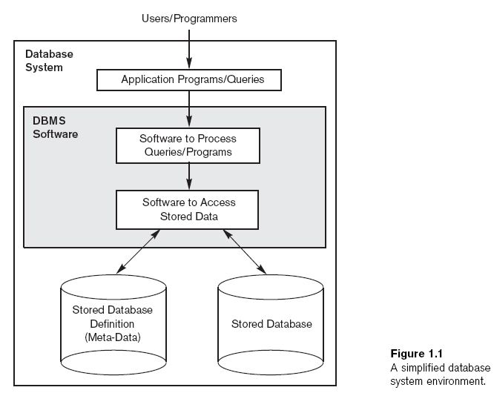
Database System Environment (made simple)

Slide 7
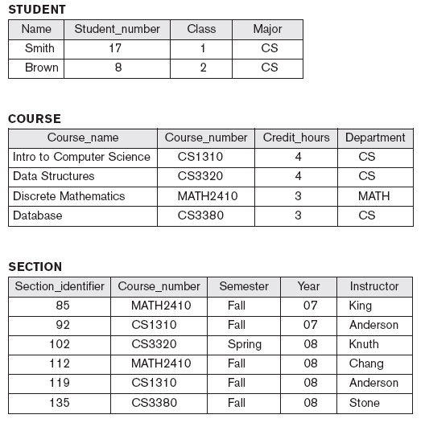
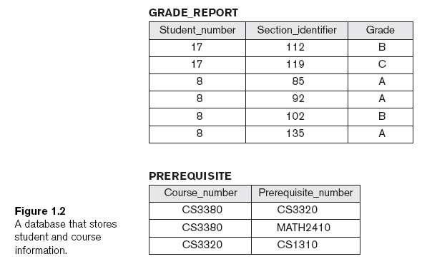
An Example: University Database
Notes:
What can we do to this?

Slide 8
Design a Database
Phases for designing a database:
  Requirements specification and analysis
  Conceptual design
  Logical design
  Physical design

Slide 9
Characteristics of Database Approach
Main characteristics of database approach
  Self-describing nature of a database system
    Database system contains complete definition of structure and constraints
    Meta-data (information stored in catalog)
    Describes structure of the database
    Database catalog used by:
      DBMS software
      Database users who need information about database structure
  Insulation between programs and data, and data abstraction
    Structure of data files is stored in DBMS catalog separately from access programs
  Support of multiple views of the data
  Sharing of data and multiuser transaction processing
    Transactions

Slide 10
Data Abstraction (more in-depth look)
Data abstraction
  Allows program-data independence and program-operation independence
Conceptual representation of data
  Does not include details of how data is stored or how operations are implemented
Data model
  Type of data abstraction used to provide conceptual representation

Slide 11
Categories of Data Models
High-level or conceptual data models
  Close to the way many users perceive data
Low-level or physical data models
  Describe the details of how data is stored on computer storage media
Representational data models
  Easily understood by end users
  Also similar to how data organized in computer storage

Slide 12
Who does what?
Database administrators (DBA) are responsible for:
  Authorizing access to the database
  Coordinating and monitoring its use
  Acquiring software and hardware resources
Database designers are responsible for:
  Identifying the data to be stored
  Choosing appropriate structures to represent and store this data
End users
  People whose jobs require access to the database
  Types (casual, naïve/parametric, sophisticated, standalone)
System analysts
  Determine requirements of end users
Application programmers
  Implement these specifications as program

Slide 13
Other types of involved personnel
DBMS system designers and implementers
  Design and implement the DBMS modules and interfaces as a software package
Tool developers
  Design and implement tools
Operators and maintenance personnel
  Responsible for running and maintenance of hardware and software environment for database system

Slide 14
Advantages of the DBMS
Controlling redundancy
  Data normalization
  Denormalization
    Sometimes necessary to use controlled redundancy to improve the performance of queries
Restricting unauthorized access
  Security and authorization subsystem
  Privileged software
Providing persistent storage for program objects
  Complex object in C++ can be stored permanently in an object-oriented DBMS
  Impedance mismatch problem
    Object-oriented database systems typically offer data structure compatibility

Slide 15
More advantages
Providing storage structures and search techniques for efficient query processing
  Indexes
  Buffering and caching
  Query processing and optimization
Providing backup and recovery
  Backup and recovery subsystem of the DBMS is responsible for recovery
Providing multiple user interfaces
  Graphical user interfaces (GUIs)
Representing complex relationships among data
  May include numerous varieties of data that are interrelated in many ways

Slide 16
More Advantages
Enforcing integrity constraints
  Referential integrity constraint
    Every section record must be related to a course record
  Key or uniqueness constraint
    Every course record must have a unique value for Course_number
  Business rules
  Inherent rules of the data model
Permit inferencing and actions using rules
  Deductive database systems
    Provide capabilities for defining deduction rules
    Inferencing new information from the stored database facts
  Trigger
    Rule activated by updates to the table
  Stored procedures
    More involved procedures to enforce rules

Slide 17
Database System Concepts and Architecture

Slide 18
Categories of Data Models
Entity
  Represents a real-world object or concept
Attribute
  Represents some property of interest
  Further describes an entity
Relationship among two or more entities
  Represents an association among the entities
  Entity-Relationship model

Slide 19
Categories of Data Models
Relational data model
  Used most frequently in traditional commercial DBMSs
Object data model
  New family of higher-level implementation data models
  Closer to conceptual data models

Slide 20
Categories of Data Models
Physical data models
  Describe how data is stored as files in the computer
  Access path
    Structure that makes the search for particular database records efficient
  Index
    Example of an access path
    Allows direct access to data using an index term or a keyword

Slide 21
Schemas, Instances, and Database State
Database schema
  Description of a database
Schema diagram
  Displays selected aspects of schema
Schema construct
  Each object in the schema
Database state or snapshot
  Data in database at a particular moment in time

Slide 22
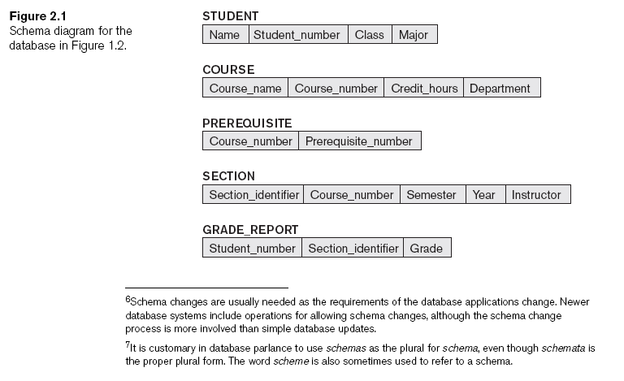
Schemas, Instances, and Database State
Notes:
Each object in the schema construct (STUDENT, COURSE)
The Schema diagram only displays some aspects of a schema such as names of record types, and data items, and some type of constraints. Many types of constraints are not represented.

Slide 23
Schemas, Instances, and Database State
Define a new database
  Specify database schema to the DBMS (empty state with no data)
Initial state
  Populated or loaded with the initial data
Valid state
  Satisfies the structure and constraints specified in the schema
Schema evolution
  Changes applied to schema as application requirements change
  Every change to the database provides us with another database state. The DBMS is partly responsible for ensuring the database is in a valid state.

Slide 24
Three-Schema Architecture and Data Independence
Internal level
  Describes physical storage structure of the database
Conceptual level
  Describes structure of the whole database for a community of users
External or view level
  Describes part of the database that a particular user group is interested in

Slide 25
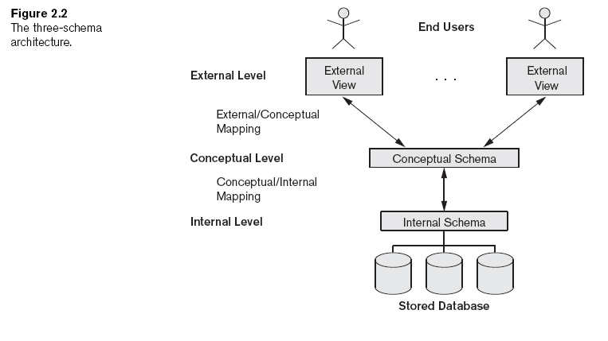
Three-Schema Architecture and Data Independence

Slide 26
Data Independence
Capacity to change the schema at one level of a database system without having to change the schema at the next higher level
Types:
  Logical data independence: capacity to change the conceptual schema without having to change external schemas or application programs
  Physical data independence: capacity to change the internal schema without having to change the conceptual schema
Notes:
Logical example: adding another record type or data item, change the constraint, or to reduce the database by removing a record type or data item
(what if we added an attribute such as course_number to GRADE_REPORT (1.2 to 1.6)
Physical example: adding another index of SEMESTER by semester and year

Slide 27
DBMS Languages
Data definition language (DDL)
  Defines both schemas
Storage definition language (SDL)
  Specifies the internal schema
View definition language (VDL)
  Specifies user views/mappings to conceptual schema
Data manipulation language (DML)
  Allows retrieval, insertion, deletion, modification
Notes:
In relational DBMSs, SQL is used in the role of VDL to define user or application views as results of predefined queries

Slide 28
DBMS Languages
High-level or nonprocedural DML
  Can be used on its own to specify complex database operations concisely
  Set-at-a-time or set-oriented
  SQL can specify and retrieve many records in a single DML statement, therefore they are set-at-a-time
Low-level or procedural DML
  Must be embedded in a general-purpose programming language
  Record-at-a-time

Slide 29
DBMS Interfaces
Menu-based interfaces for Web clients or browsing
Forms-based interfaces
Graphical user interfaces
Natural language interfaces
Speech input and output
Interfaces for parametric users
Interfaces for the DBA

Slide 30
The Database System Environment
DBMS component modules
  Buffer management
  Stored data manager
  DDL compiler
  Interactive query interface
    Query compiler
    Query optimizer
  Precompiler

Slide 31
The Database System Environment
DBMS component modules
  Runtime database processor
  System catalog
  Concurrency control system
  Backup and recovery system

Slide 32
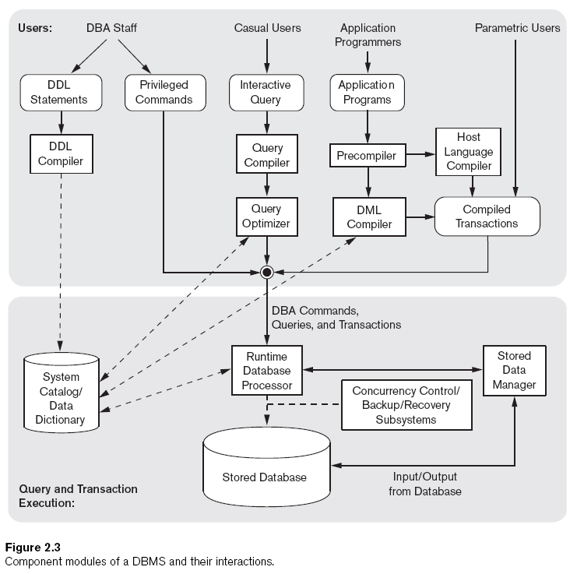

Slide 33
Database System Utilities
Loading
  Load existing data files
Backup
  Creates a backup copy of the database
Database storage reorganization
  Reorganize a set of database files into different file organizations
Performance monitoring
  Monitors database usage and provides statistics to the DBA

Slide 34
Tools, Application Environments, and Communications Facilities
CASE Tools
Data dictionary (data repository) system
  Stores design decisions, usage standards, application program descriptions, and user information
Application development environments
Communications software

Slide 35
Centralized and Client/Server Architectures for DBMSs
Centralized DBMSs Architecture
  All DBMS functionality, application program execution, and user interface processing carried out on one machine

Slide 36
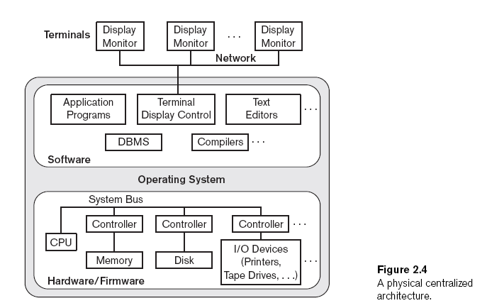

Slide 37
Basic Client/Server Architectures
Servers with specific functionalities
  File server
    Maintains the files of the client machines.
  Printer server
    Connected to various printers; all print requests by the clients are forwarded to this machine
  Web servers or e-mail servers

Slide 38
Basic Client/Server Architectures (cont'd.)
Client machines
  Provide user with:
    Appropriate interfaces to utilize these servers
    Local processing power to run local applications

Slide 39
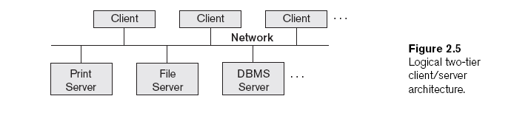
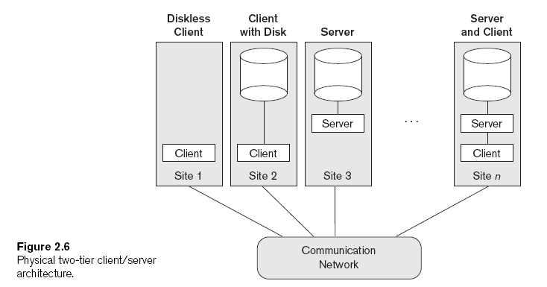

Slide 40
Basic Client/Server Architectures (cont'd.)
Client
  User machine that provides user interface capabilities and local processing
Server
  System containing both hardware and software
  Provides services to the client machines
    Such as file access, printing, archiving, or database access

Slide 41
Two-Tier Client/Server Architectures for DBMSs
Server handles
  Query and transaction functionality related to SQL processing
Client handles
  User interface programs and application programs
Open Database Connectivity (ODBC)
  Provides application programming interface (API)
  Allows client-side programs to call the DBMS
    Both client and server machines must have the necessary software installed
JDBC
  Allows Java client programs to access one or more DBMSs through a standard interface

Slide 42
Three-Tier and n-Tier Architectures for Web Applications
Application server or Web server
  Adds intermediate layer between client and the database server
  Runs application programs and stores business rules
N-tier
  Divide the layers between the user and the stored data further into finer components

Slide 43
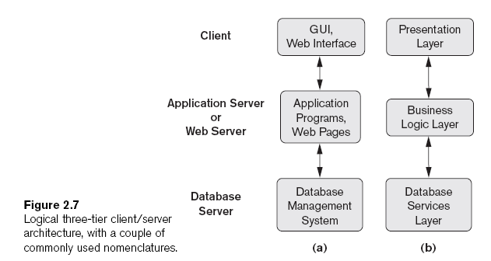

Slide 44
Classification of Database
Management Systems
Data model
  Relational
  Object
  Hierarchical and network (legacy)
  Native XML DBMS (XML emerged as a standard for exchanging data over the Web)
Number of users
  Single-user
  Multiuser

Slide 45
Classification of Database
Management Systems
Number of sites
  Centralized
  Distributed
    Homogeneous
    Heterogeneous
Cost
  Open source
  Different types of licensing
Types of access path options
General or special-purpose

